Slide 1
Real-time subscriptions

Slide 2
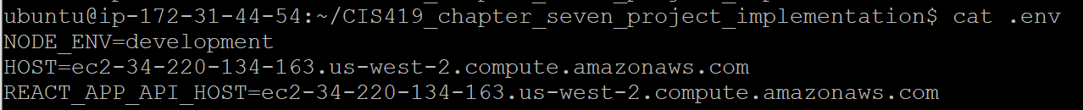
.env

Slide 3
DNS updates for new node
Src/client/apollo/index.js
Src/server/ssr/apollo.js
<project-root> /Webpack.client.config.js

Slide 4
Verify and test chat/ messaging capability in your graphbook application
Formally start with chapter 10 material

Slide 5
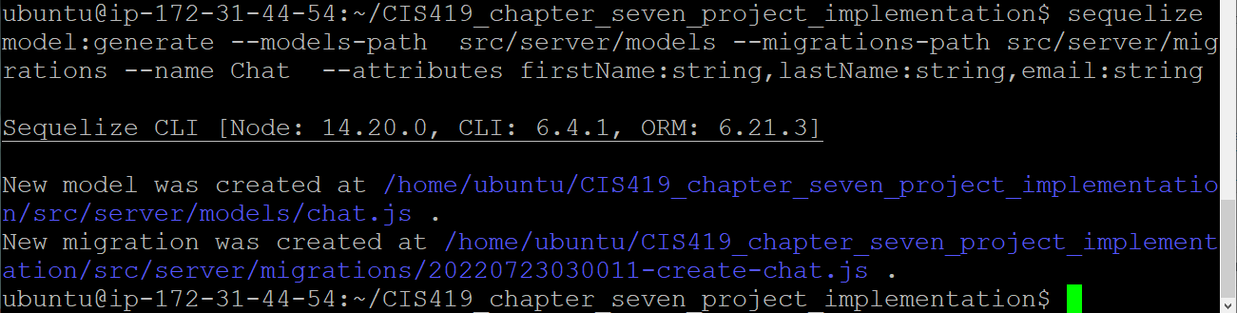

Slide 6
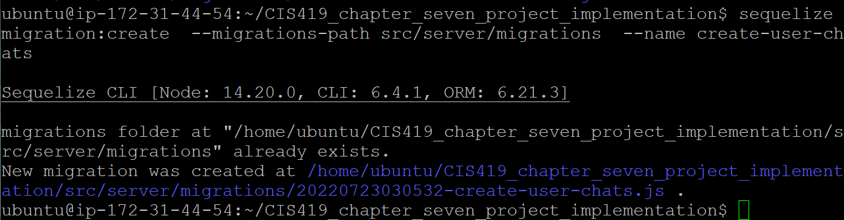

Slide 7
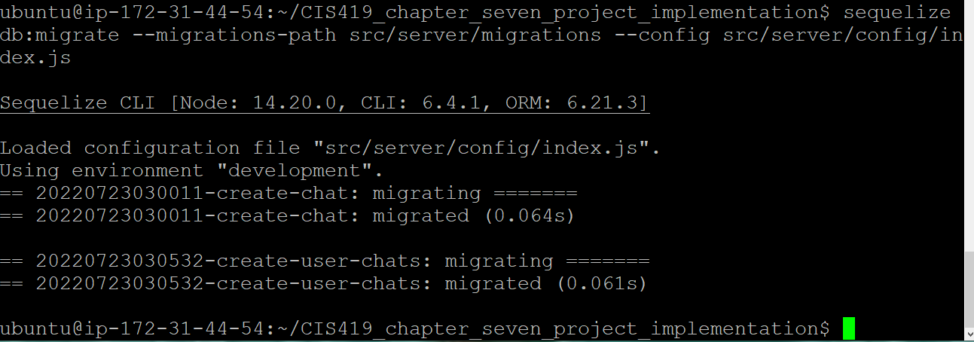

Slide 8
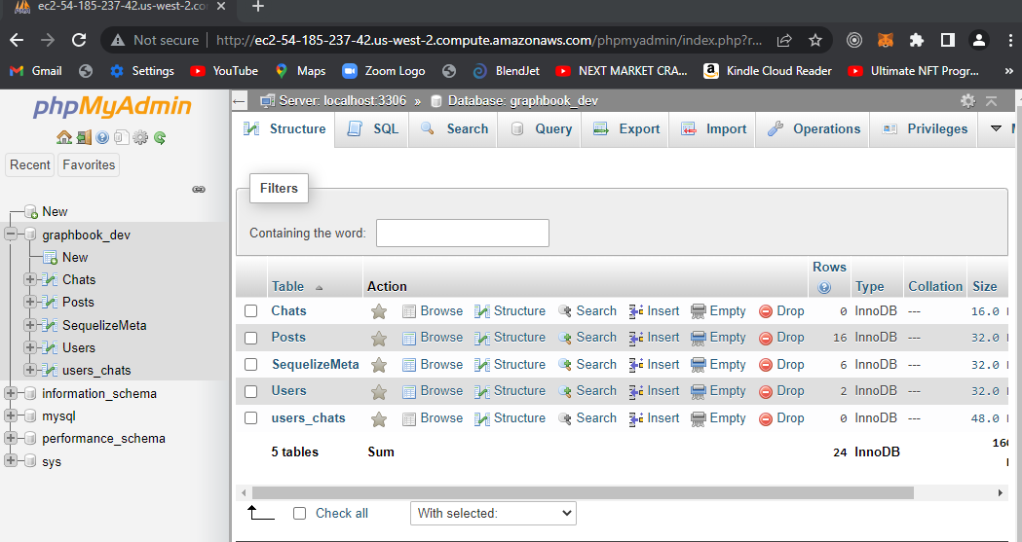

Slide 9
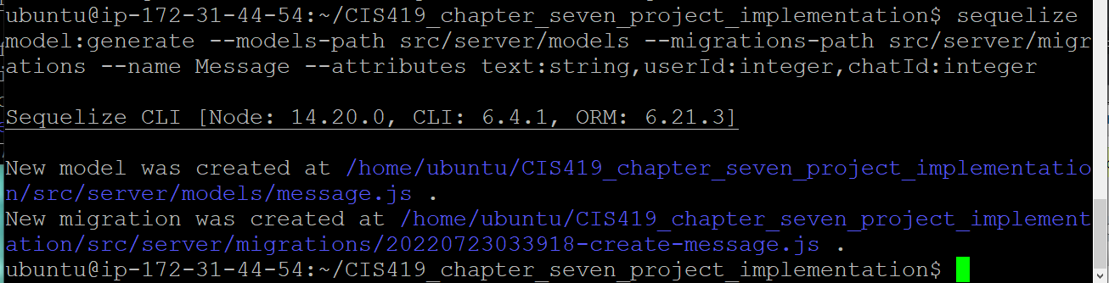

Slide 10
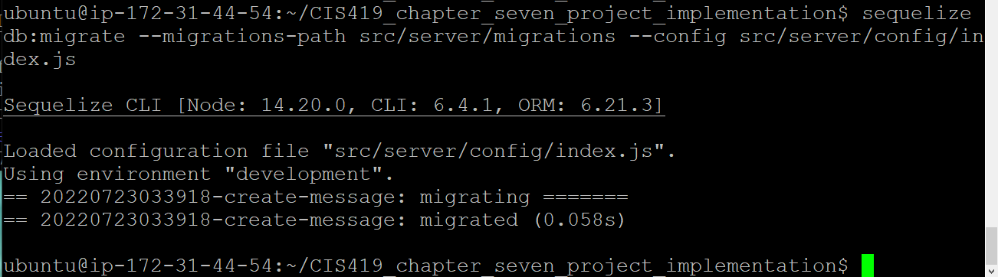

Slide 12
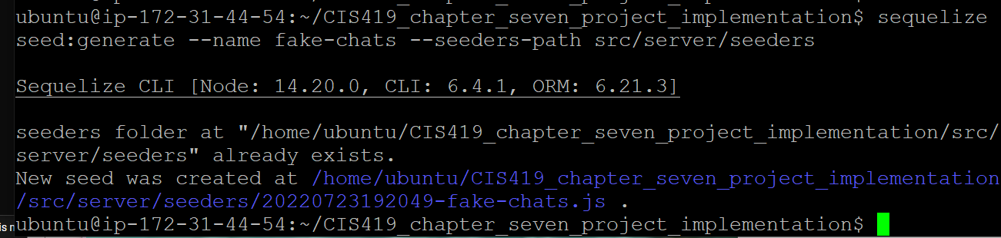

Slide 13
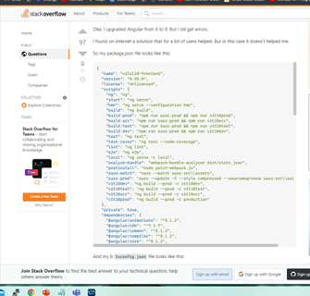

Slide 15
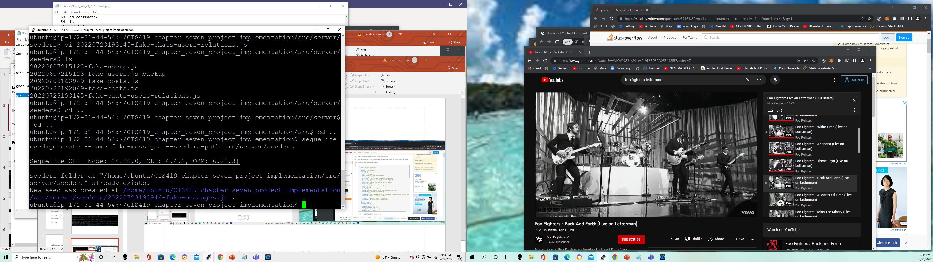

Slide 16
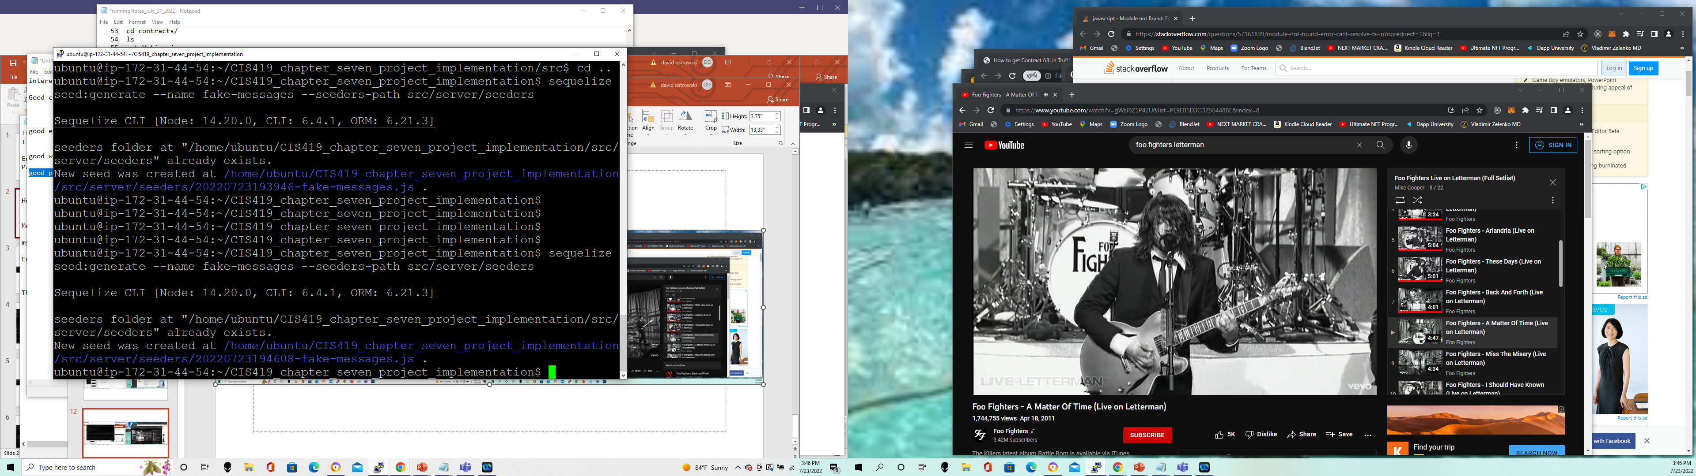

Slide 17
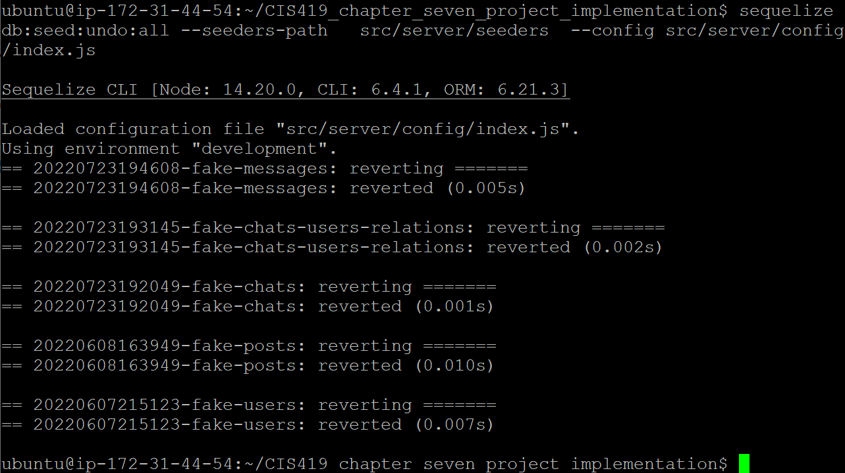

Slide 18
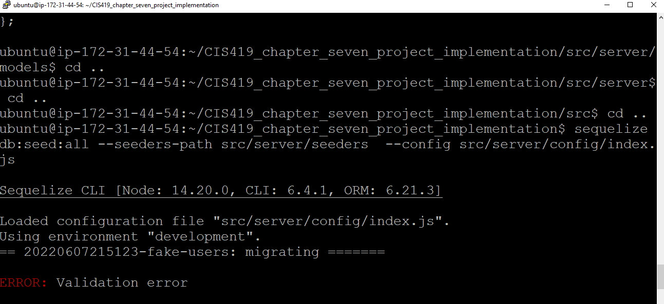

Slide 19
In the case of a validation error you might want to try to delete (perform a db:seed:undo:all) and run allof your migrations over…..)
To test with postman you have to run:
npm run server (!)

Slide 20
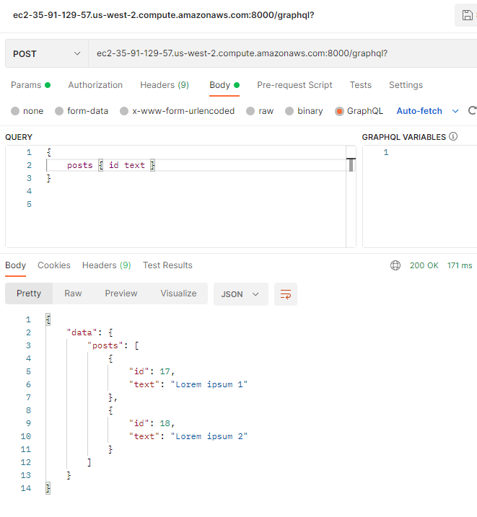

Slide 21
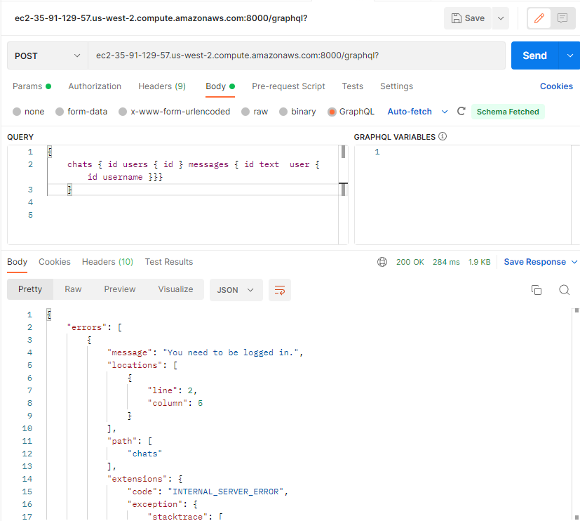

Slide 22
Chats / messages not showing in the postman
1) updated the src/server/models user.js, chat.js, message.js
2) dropped user_* table
Dropped chat table
Dropped messages table
(not work – this time you need to do migrate:undo:all )
Then try the migrations again!
3)

Slide 24
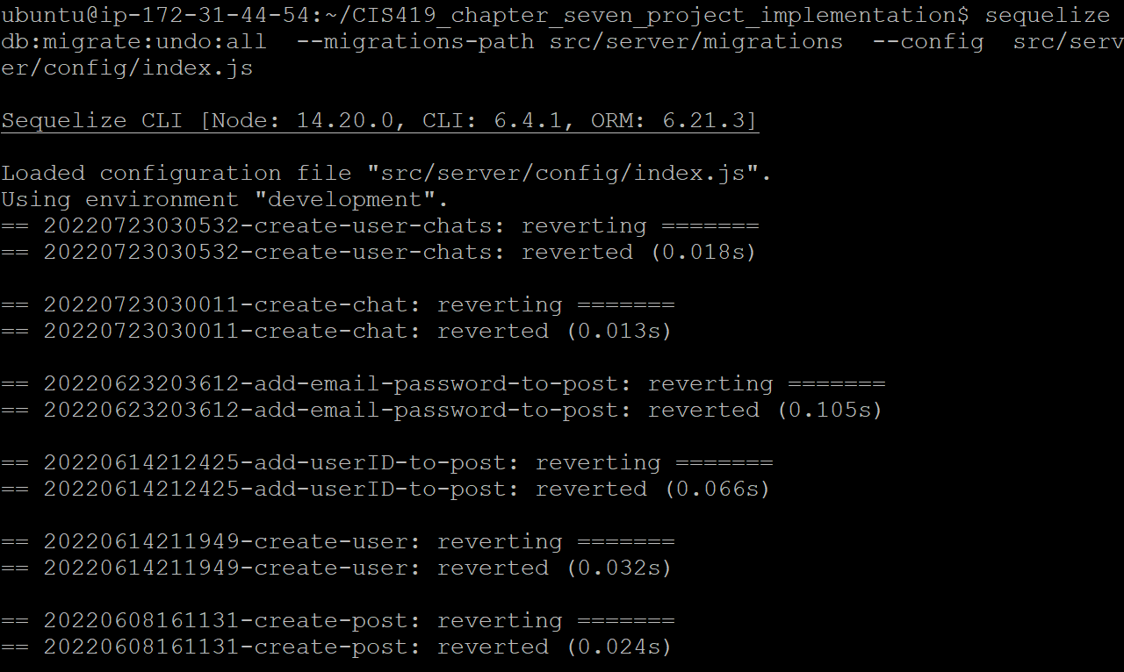

Slide 25
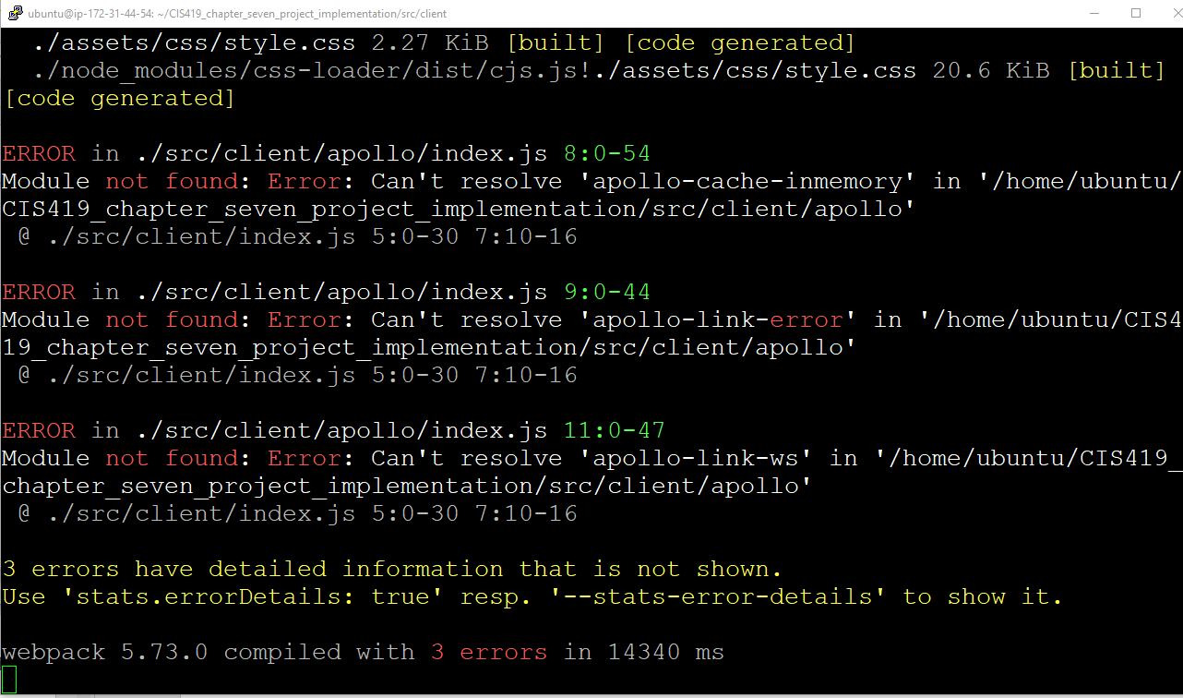

Slide 26
July 26,2022
At this point, back out the chapter 10 changes
Try to run the simplified graphql against the ‘fake messages’
NOTE: the ‘addChat’ is not functional in the source code to my knowledge.

Slide 27
Real-time Subscriptions
Implemented news feed, chat and profile pages
Problem: User has to either refresh the browser or set up a pollinterval property to keep the display up to date.
HTTP == one time requests ( think mail or certified mail perhaps)
Solution : websockets which establish a bi-directional communication ( the difference is you have one request and you then maintain the back-and-forth communication ) ( think a phone call that is always on the call to receive or send information vs mail )

Slide 28
Websockets
Disadv. - not a standard approach for implementing APIs
HTTP can be optimized (cached and proxied) in a much easier fashion
Websockets can be hard to scale
With Apollo, graphql-subscriptions provides the ability to connect our graphql backend with a publish-subscribe (pubSub) system.

Slide 29
To start: you need to create a new subscription type that will exist next to the RootQuery, RootMutation types
Set up events or entities that a client can subscribe to and receive updates inside the new subscription type.
Instead of returning real data it will return a special object to allow a client to subscribe to events for the specific entity.
The backend will call a publish method that sends the new data through the subscription to all clients

Slide 31
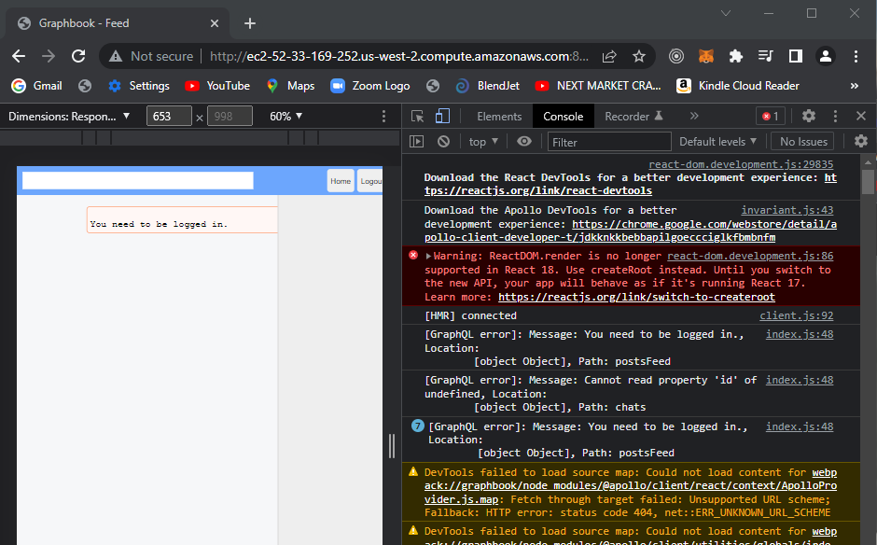

Slide 32
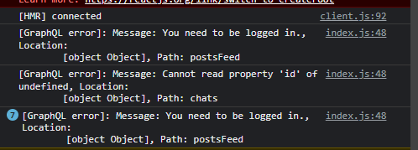
Area to address
Src/server/index
I went into the schema.js and took the authorization from the postfeed.
Src/server/services/graphql/schema.js
Why isn’t the prompt page showing?
Root cause was pulling out the “auth” in the
Graphql schemas - created the grief for me.

Slide 34
.env

Slide 35
DNS updates for new node
Src/client/apollo/index.js
Src/server/ssr/apollo.js
<project-root> /Webpack.client.config.js

Slide 36
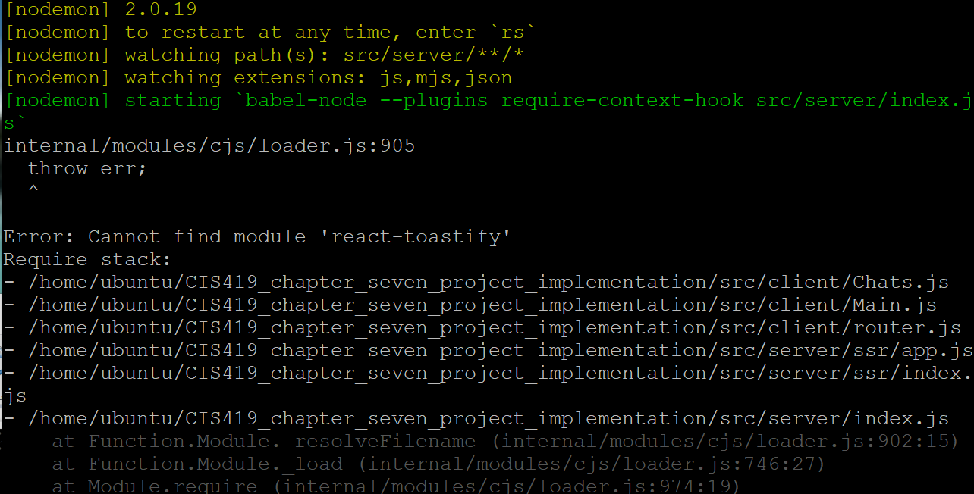

Slide 38
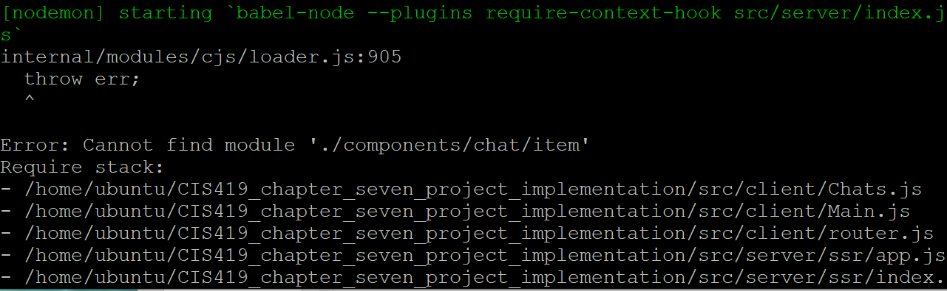

Slide 39
Add
Src/client/components/chat/item.js

Slide 40
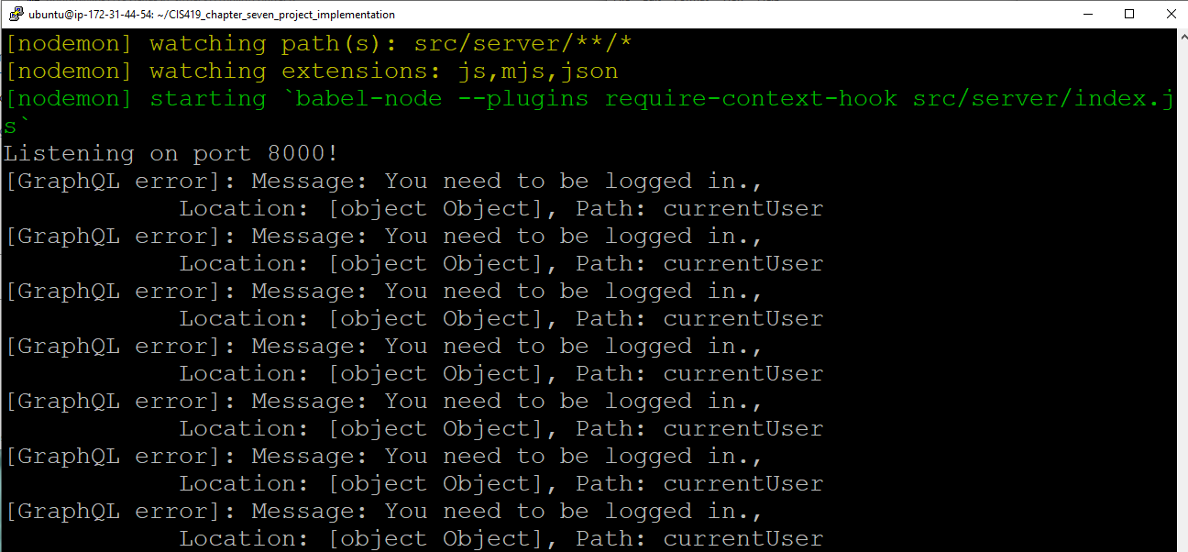
This message is from
Src/
Server/
Services/
Graphql/
Auth.js
NOTE:
This is corrected by clearing
Out your browser!!!!

Slide 41
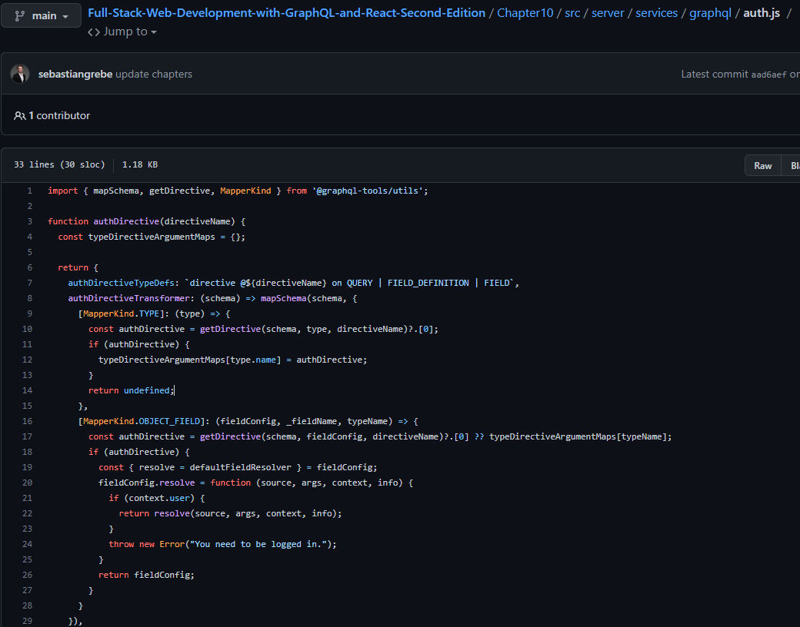

Slide 42
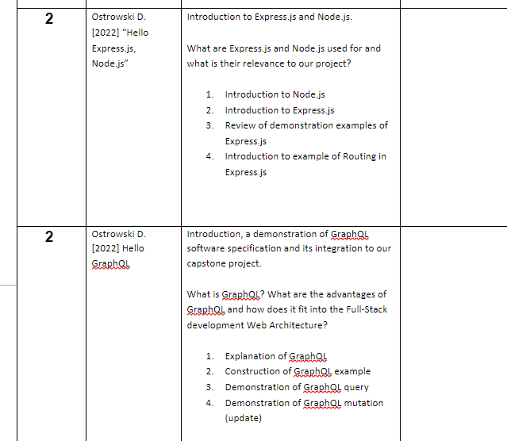

Slide 43
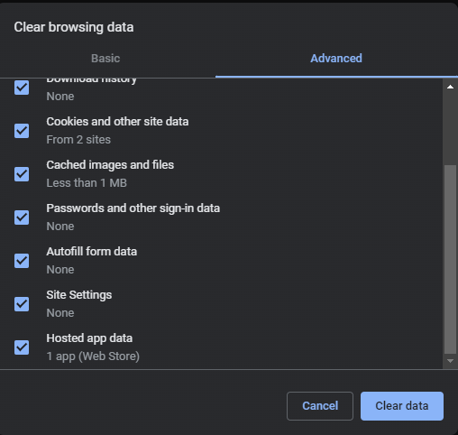
NOTE:
Do advanced “clear of browsing data” for all settings / cookies etc…
For entire history , not just the last day.

Slide 44
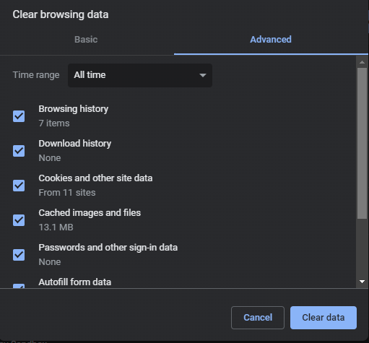
Select “all time”
Select all options
Browsing history,
Download
Cookies,
Passwords
Etc…..

Slide 45
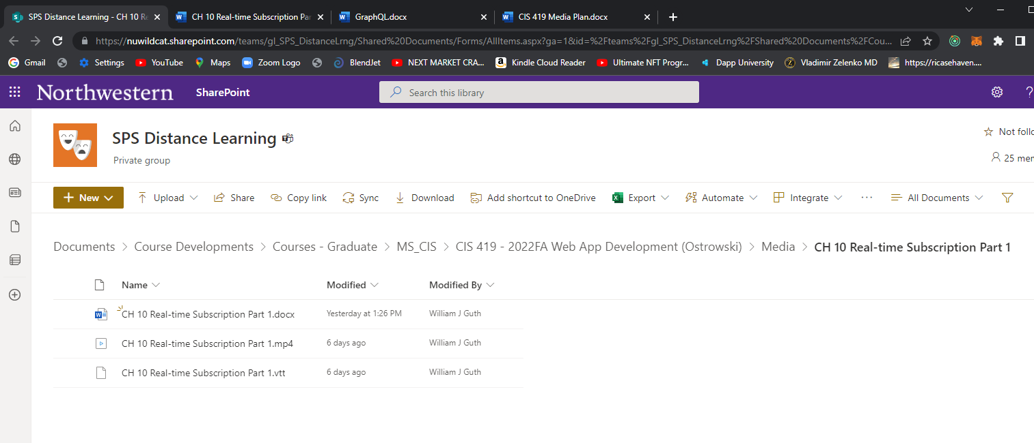

Slide 46
Canvas.northwestern.edu
(after logged in …)
CCS_2022FA_MSCIS_419

Slide 47
